Slide 1
Gradient Descent
Mahipal Singh

Slide 2
What is Gradient Descent?
A step-by-step algorithm to find the best line (θ₀, θ₁) in linear regression by minimizing prediction error.

Slide 3
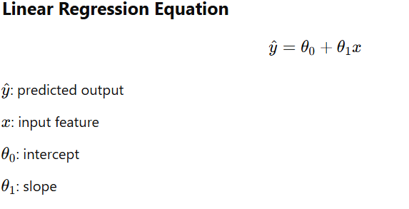

Slide 4
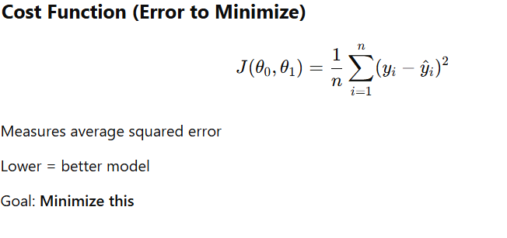

Slide 5
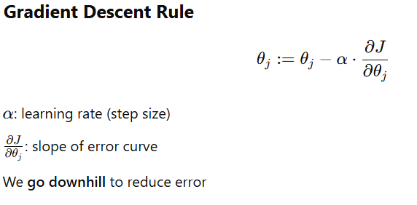

Slide 6
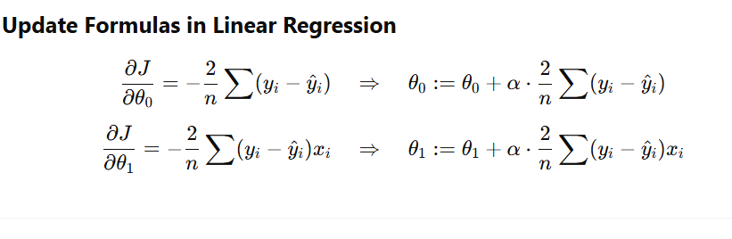

Slide 7
Key Takeaway
Gradient descent helps the model learn from mistakes and find the most accurate line by minimizing total error step-by-step.

